Slide 1
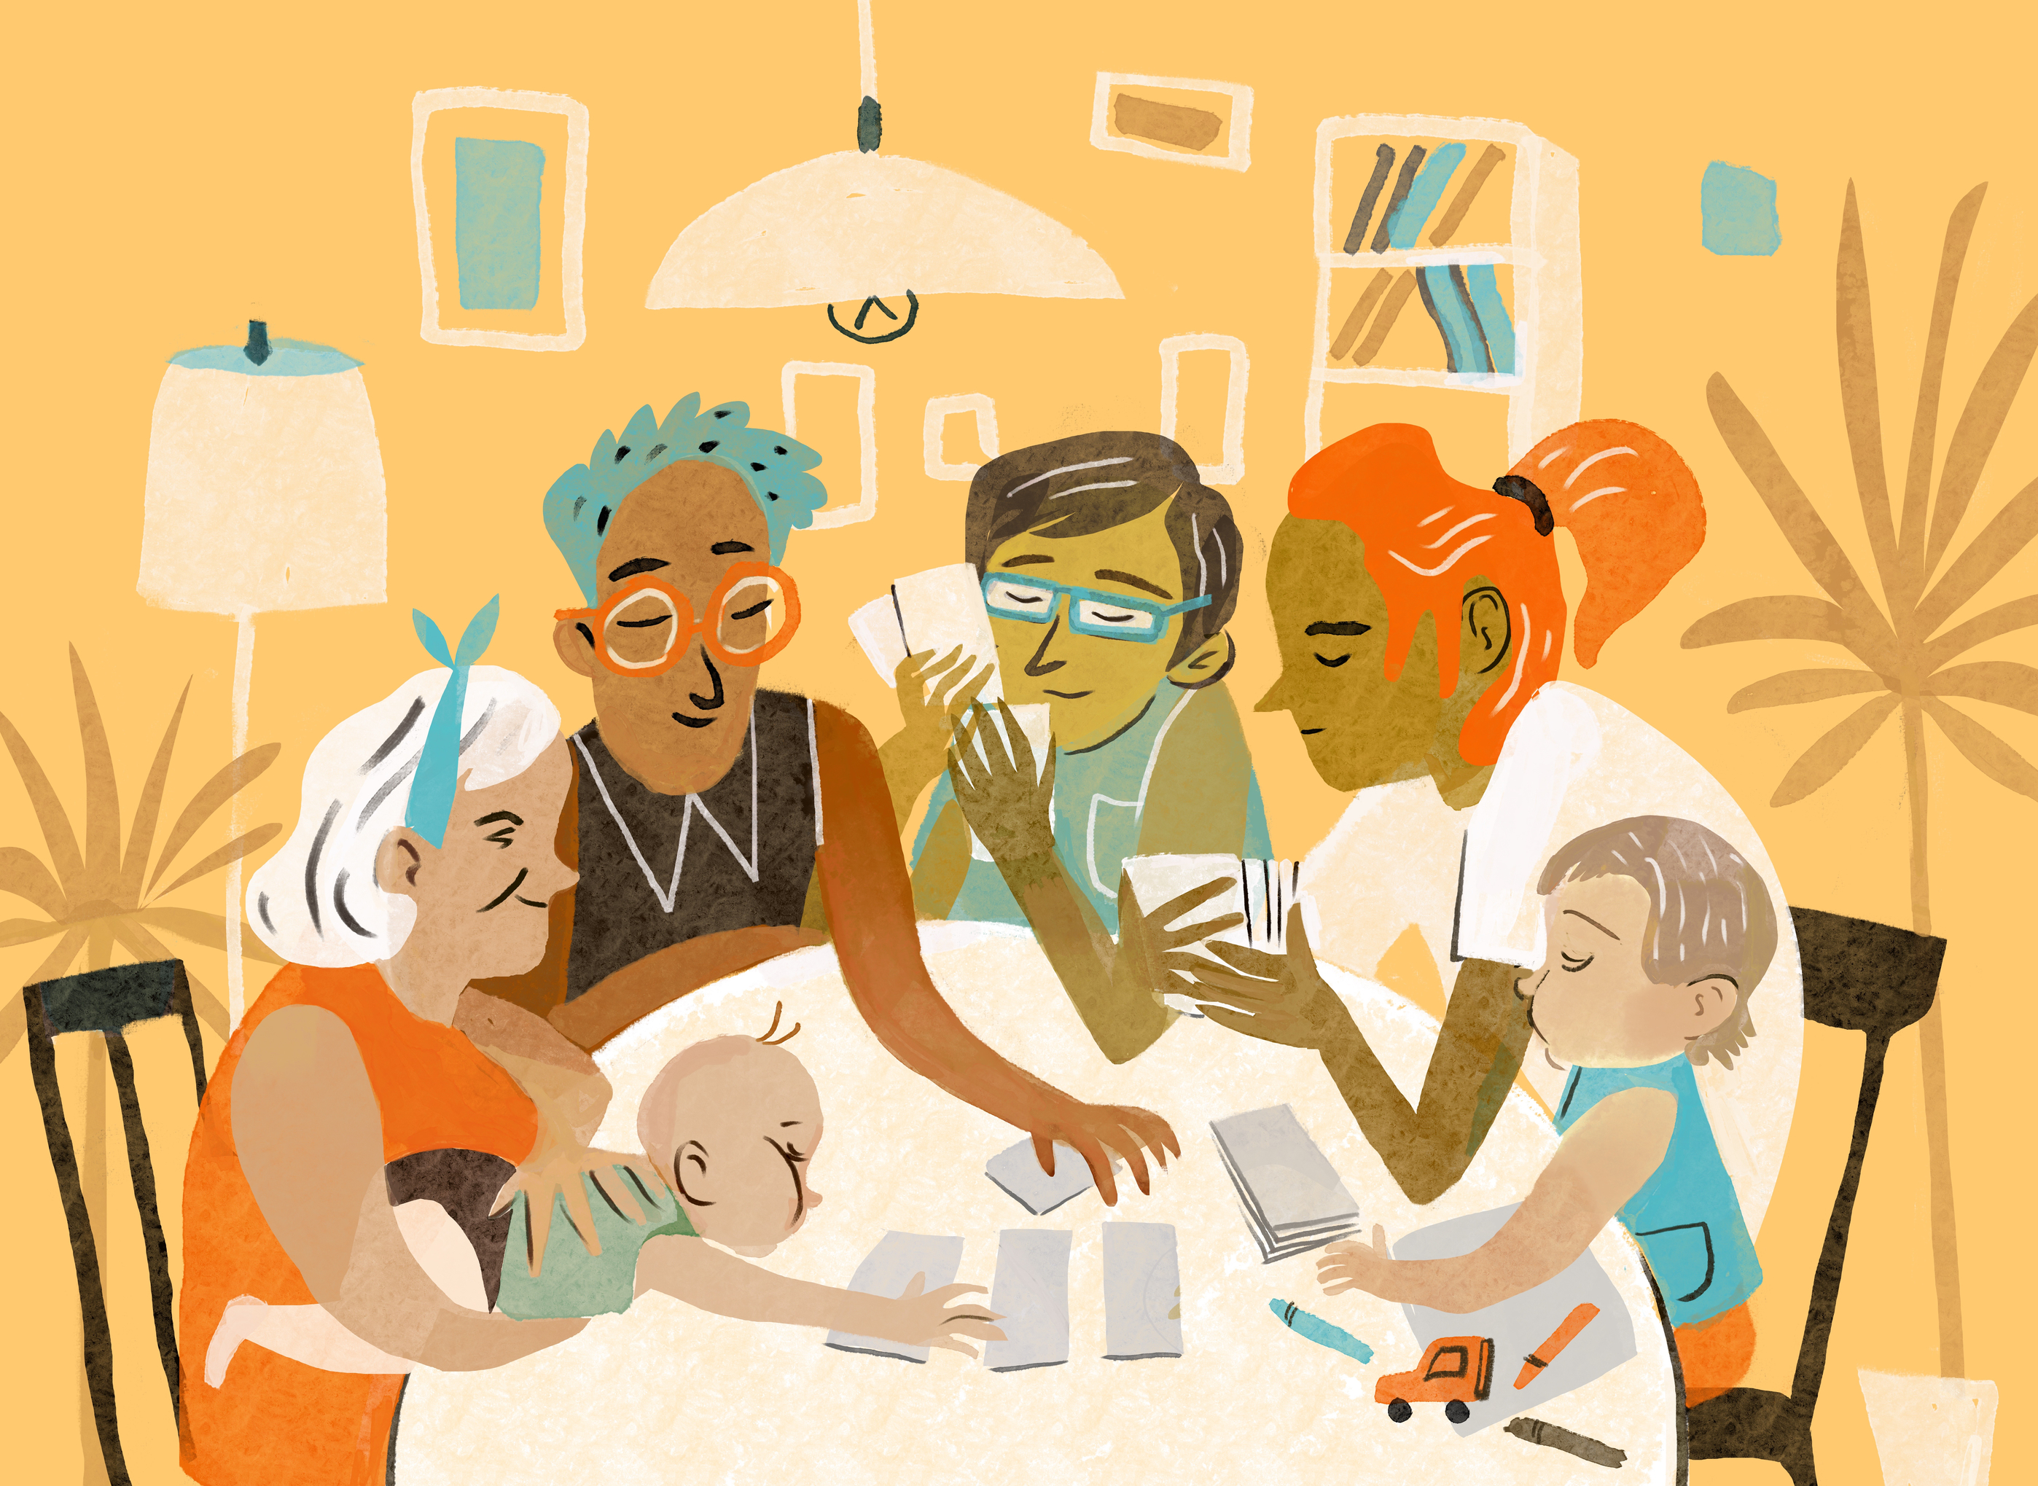
BLOOD RELATIONS
LOGICAL REASONING

Slide 2
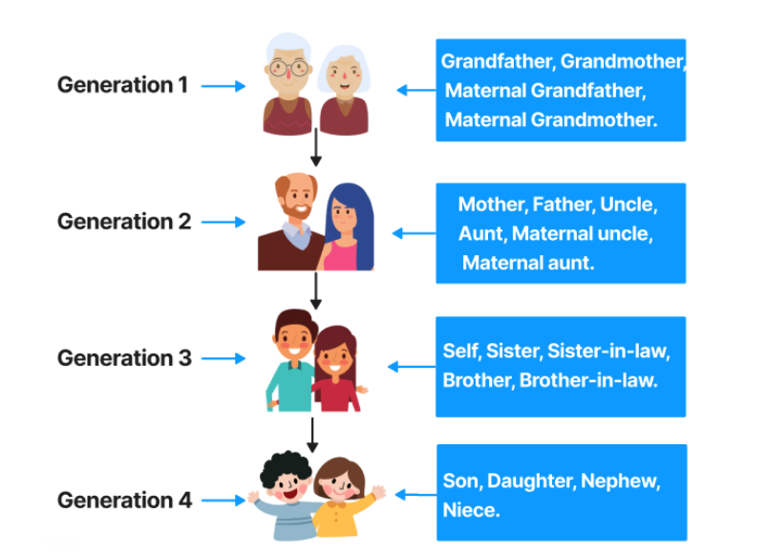
FAMILY TREE

Slide 3
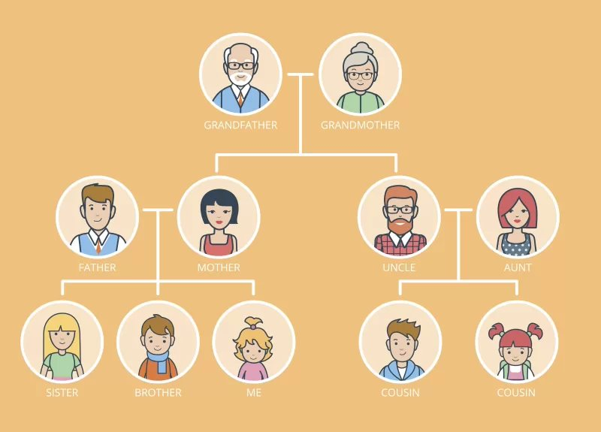

Slide 4
Symbols Used for drawing Family tree
The symbol for a Male is "+"
The symbol for a Female is "-"
The symbol for a Married couple is "⇔"
The symbol for siblings is "="

Slide 5
Example
A is the wife of B. C is the son of A and D is the daughter of B. C married to E and F married to D. G is the don of C and H is the daughter of D.
A (-) ⇔ B (+)
|
----------------------------
| |
C (+)⇔ E (-) D (-)⇔ F (+)
| |
G (+) H (-)

Slide 6
1) If A is the brother of B; B is the sister of C; and C is the father of D, how D is related to A?​
A. Brother​
B. Sister​
C. Nephew​
D. Cannot be determined

Slide 7
2)Veena who is the sister-in-law of Ashok, is the daughter-in-law of Kalyani. Dheeraj is the father of Sudeep who is the only brother of Ashok. How Kalyani is related to Ashok?
A. Mother-in-law
B. Aunt
C. Wife
D. None of these

Slide 8
3)Six members of a family namely P,Q,R,S,T and U are having dinner sitting around a circular table. R is the daughter of S, who is not the father of R. S and T are married couple. U is the sister of S. P is the son of T. Q is the sister of R. How many female members are there in the family?
A.1
B.2
C.3
D.4

Slide 9
4)In one family there are several children in which each girl has as many brothers as she has sisters but each boy has sisters which are twice of brothers he has. Then how many brothers and sisters are they?
A. 4 Brothers, 3 Sisters
B. 4 Sisters, 3 Brothers
C. 4 Brothers, 4 Sisters
D. Cannot say

Slide 10
5)In Mr. Mehta’s family, there are one grandfather, one grandmother, two fathers, two mothers, one father-in-law, one mother-in-law, four children, three grandchildren, one brother, two sisters, two sons, two daughters and one daughter-in-law. How many members are there in Mr. Mehta’s family?
A. 17 members
B. 23 members
C. 9 members
D. 7 members

Slide 11
6)Pointing to a photograph of a boy Suresh said, "He is the son of the only son of my mother." How is Suresh related to that boy?
A. Brother
B. Uncle
C. Cousin
D. Father

Slide 12
7)Introducing a boy, a girl said, "He is the son of the daughter of the father of my uncle." How is the boy related to the girl?
A. Brother
B. Nephew
C. Uncle
D. Son-in-law

Slide 13
8)How is Ravi’s sister’s husband’s father’s daughter related to Ravi’s only sister?
A. Mother in law
B. Sister in law
C. Sister
D. Aunt

Slide 14
9)If A + B means A is the sister of B; A x B means A is the wife of B, A % B means A is the father of B and A - B means A is the brother of B. Which of the following means T is the daughter of P?
A. P x Q % R + S - T
B. P x Q % R - T + S
C. P x Q % R + T - S
D. P x Q % R + S + T

Slide 15
10)If A + B means A is the mother of B; A - B means A is the brother B; A % B means A is the father of B and A x B means A is the sister of B, which of the following shows that P is the maternal uncle of Q?
A. Q - N + M x P
B. P + S x N - Q
C. P - M + N x Q
D. Q - S % Px N

Slide 16
In a family – A, B, C, D, E and F –are the six members. A is the brother of B, who is the mother of C. C is the daughter of D, who is the son of E. E is the wife of F.
11.How is E related to B?
(1)Mother-in-law (2)Mother
(3)Son (4)Daughter
(5)Daughter-in-law
12.How is A related to C?
(1)Aunt (2)Uncle
(3)Brother (4)Cousin
(5)Cannot be determined

